Slide 1
Real-Time SQL Project: Comprehensive Analysis of the 2024 India General Elections Results

Slide 2
In this advanced SQL project, I conducted a detailed analysis of the 2024 India General Elections results using a MySQL database. This hands-on project involved working with five CSV files, providing a real-world scenario that allowed me to develop invaluable skills in data analysis and SQL.
Key Highlights of the Project:
Advanced Join Operations:
Successfully executed complex join operations across multiple tables to extract meaningful insights from interconnected datasets.
2. ETL (Extract, Transform, Load) Processes:
Applied robust ETL techniques to clean, transform, and load real-world data into the database, ensuring data integrity and consistency.

Slide 3
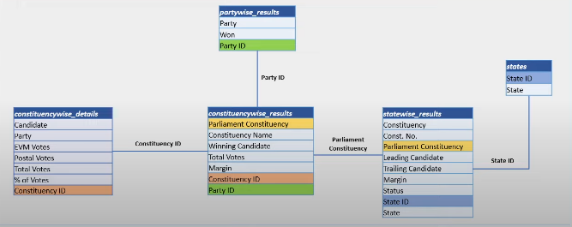
3. Schema Design and ERD Implementation:
Designed and implemented database schemas and Entity-Relationship Diagrams (ERDs) to establish clear relationships between the data entities.

Slide 4
Utilization of Advanced SQL Functions:
Used advanced SQL functions and techniques for complex data manipulations, such as ranking, window functions, and aggregations.

Slide 5

SQL QUERIES
Q1- What is the total number of seats available for elections in each state?
Ans 1- Create database India_election_Result_2024;
use India_election_Result_2024;
select * from constituencywise_results;
/* 1- Total seats */
Select count(distinct Parliament_Constituency) as total_seats
from constituencywise_results;

Slide 6
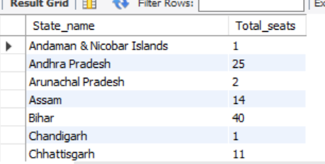
2- what is the total number of seats available in each state for election?
Select
s.state AS State_name,
count(distinct cr.Parliament_Constituency) as Total_seats
from Constituencywise_results as cr
INNER JOIN statewise_results as sr ON cr.Parliament_Constituency = sr.Parliament_Constituency
INNER JOIN States as s ON sr.state_ID = s.state_ID
group by s.state;

Slide 7
Q3- Total seats won by NDA Alliance
select
SUM(case
when Party IN (
'Bharatiya Janata Party - BJP',
'Telugu Desam - TDP',
'Janata Dal (United) - JD(U)',
'Hindustani Awam Morcha (Secular) - HAMS',
'Apna Dal (Soneylal) - ADAL',
'Lok Janshakti Party(Ram Vilas) - LJPRV',
'AJSU Party - AJSUP’,
'Asom Gana Parishad - AGP',
'Janasena Party - JnP',
'Janata Dal (Secular) - JD(S)',
'Nationalist Congress Party - NCP',
'Shiv Sena - SHS',
'Sikkim Krantikari Morcha - SKM',
'United People Party, Liberal - UPPL',
'Rashtriya Lok Dal - RLD'

Slide 8

'Sikkim Krantikari Morcha - SKM',
'United People Party, Liberal - UPPL',
'Rashtriya Lok Dal - RLD'
) then Won
ELSE 0
END) AS NDA_Total_Seats_Won
from partywise_results;

Slide 9
Q4- Total Individual seats won by each NDA ALLIANCE PARTY
select
party as Party_Name, Won as Seats_Won
from partywise_results
where party IN (
'Bharatiya Janata Party - BJP',
'Telugu Desam - TDP',
'Janata Dal (United) - JD(U)',
'Hindustani Awam Morcha (Secular) - HAMS',
'Apna Dal (Soneylal) - ADAL',
'Lok Janshakti Party(Ram Vilas) - LJPRV',
'AJSU Party - AJSUP',
'Asom Gana Parishad - AGP’,
'Janasena Party - JnP',
'Janata Dal (Secular) - JD(S)',
'Nationalist Congress Party - NCP',
'Sikkim Krantikari Morcha - SKM',
'United People Party, Liberal - UPPL',
'Rashtriya Lok Dal - RLD')

Slide 10
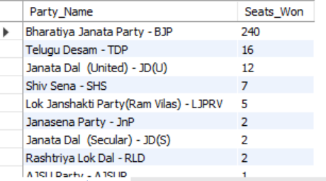
'Shiv Sena - SHS',
'Sikkim Krantikari Morcha - SKM',
'United People Party, Liberal - UPPL',
'Rashtriya Lok Dal - RLD')
ORDER BY Seats_Won DESC;

Slide 11
Q5- Total Seats Won by I.N.D.I.A. Alliance
select
SUM(case
when Party IN (
'Indian National Congress - INC',
'Aam Aadmi Party - AAAP',
'All India Trinamool Congress - AITC',
'Shiv Sena (Uddhav Balasaheb Thackrey) - SHSUBT',
'Samajwadi Party - SP',
'Dravida Munnetra Kazhagam - DMK',
'Nationalist Congress Party Sharadchandra Pawar – NCPSP’,
'Rashtriya Janata Dal - RJD',
'Jharkhand Mukti Morcha - JMM’,
'Communist Party of India (Marxist) - CPI(M)',
'Indian Union Muslim League - IUML',
'Jammu & Kashmir National Conference - JKN',
'Communist Party of India - CPI',

Slide 12
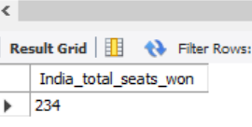
'Kerala Congress - KEC’,
'Viduthalai Chiruthaigal Katchi - VCK',
'Revolutionary Socialist Party - RSP',
'Marumalarchi Dravida Munnetra Kazhagam - MDMK',
'Communist Party of India (Marxist-Leninist) (Liberation) - CPI(ML)(L)',
'Rashtriya Loktantrik Party - RLTP',
'Bharat Adivasi Party - BHRTADVSIP'
) then Won
else 0
END) AS India_total_seats_won
From partywise_results;

Slide 13
/*6- Total seats won by each NDA ALLIANCE PARTY*/
select
party as Party_Name, Won as Seats_Won
from partywise_results
where party IN (
'Indian National Congress - INC',
'Aam Aadmi Party - AAAP',
'All India Trinamool Congress - AITC',
'Shiv Sena (Uddhav Balasaheb Thackrey) - SHSUBT',
'Samajwadi Party - SP',
'Dravida Munnetra Kazhagam - DMK',
'Nationalist Congress Party Sharadchandra Pawar - NCPSP',
'Rashtriya Janata Dal - RJD',
'Jharkhand Mukti Morcha - JMM',
'Communist Party of India (Marxist) - CPI(M)',
'Jammu & Kashmir National Conference - JKN',

Slide 14
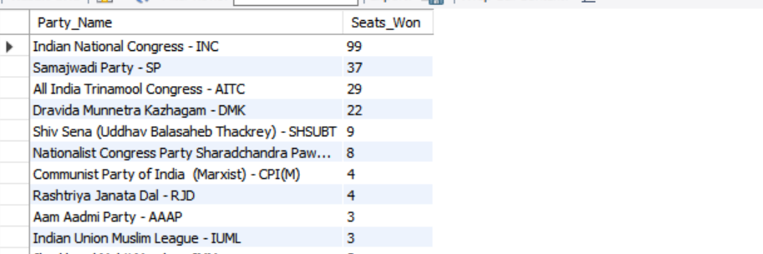
'Communist Party of India - CPI',
'Kerala Congress - KEC',
'Viduthalai Chiruthaigal Katchi - VCK',
'Revolutionary Socialist Party - RSP',
'Marumalarchi Dravida Munnetra Kazhagam - MDMK',
'Communist Party of India (Marxist-Leninist) (Liberation) - CPI(ML)(L)',
'Rashtriya Loktantrik Party - RLTP',
'Bharat Adivasi Party - BHRTADVSIP')
order by Seats_Won desc;

Slide 15
7- Add a new column field in table partywise_results to get the Party Allianz as N.D.A, I.N.D.I.A and OTHER
Alter Table partywise_results
ADD column Party_Alliance varchar(50);
update partywise_results
set Party_Alliance = 'I.N.D.I.A'
WHERE party IN ('Indian National Congress - INC',
'Aam Aadmi Party - AAAP',
'All India Trinamool Congress - AITC',
'Shiv Sena (Uddhav Balasaheb Thackrey) - SHSUBT',
'Samajwadi Party - SP',
'Dravida Munnetra Kazhagam - DMK',
'Nationalist Congress Party Sharadchandra Pawar - NCPSP',
'Rashtriya Janata Dal - RJD’,
'Jharkhand Mukti Morcha - JMM',
'Communist Party of India (Marxist) - CPI(M)',

Slide 16
'Indian Union Muslim League - IUML',
'Jammu & Kashmir National Conference - JKN',
'Communist Party of India - CPI',
'Kerala Congress - KEC',
'Viduthalai Chiruthaigal Katchi - VCK',
'Revolutionary Socialist Party - RSP',
'Marumalarchi Dravida Munnetra Kazhagam - MDMK',
'Communist Party of India (Marxist-Leninist) (Liberation) - CPI(ML)(L)',
'Rashtriya Loktantrik Party - RLTP',
'Bharat Adivasi Party - BHRTADVSIP');
update partywise_results
set Party_Alliance = 'N.D.A’
WHERE party in (
'Bharatiya Janata Party – BJP
'Telugu Desam - TDP',

Slide 17
'Janata Dal (United) - JD(U)’,
'Hindustani Awam Morcha (Secular) - HAMS',
'Apna Dal (Soneylal) - ADAL',
'Lok Janshakti Party(Ram Vilas) - LJPRV',
'AJSU Party - AJSUP',
'Asom Gana Parishad - AGP',
'Janasena Party - JnP',
'Janata Dal (Secular) - JD(S)',
'Nationalist Congress Party - NCP',
'Shiv Sena - SHS',
'Sikkim Krantikari Morcha - SKM',
'United People Party, Liberal - UPPL',
'Rashtriya Lok Dal - RLD');
update partywise_results
set Party_Alliance = 'OTHERS’

Slide 18
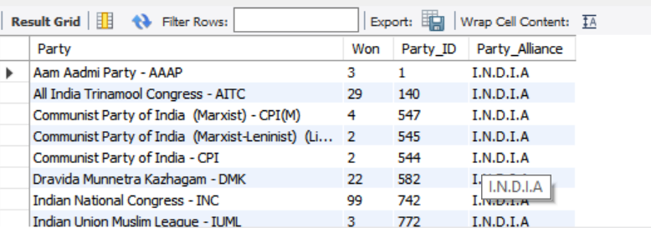
where Party_Alliance is NULL;
set sql_safe_updates = 0;
8- Which party alliance (NDA, I.N.D.I.A, or OTHER) won the most seats across all states?
SELECT Party_Alliance,
sum(Won) as Total_seats_Won
from Partywise_results
group by Party_Alliance
order by sum(Won) desc;

Slide 19
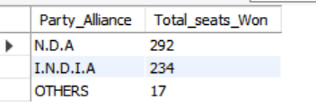
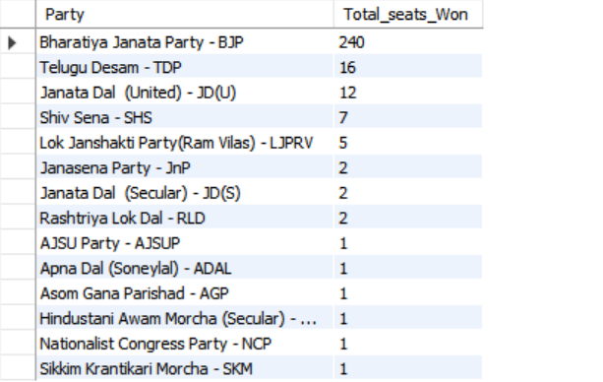
/*ONLY NDA ALLIANZ SEATS */
SELECT Party,
Won as Total_seats_Won
from Partywise_results
where Party_Alliance = 'N.D.A'
order by Won desc;

Slide 20
9- Winning candidate's name, their party name, total votes, and the margin of victory for a
specific state and constituency?
SELECT cr.Winning_Candidate, p.party, p.Party_Alliance, cr.Total_Votes, cr.Margin, s.state,
cr.Constituency_Name from constituencywise_results as cr
inner join partywise_results p ON cr.Party_ID = p.Party_ID
inner join statewise_results sr ON cr.Parliament_Constituency = sr.Parliament_Constituency
inner join states s ON sr.State_ID = s.State_ID
where s.State = 'West Bengal' AND cr.Constituency_Name = 'KOLKATAUTTAR’;

Slide 21
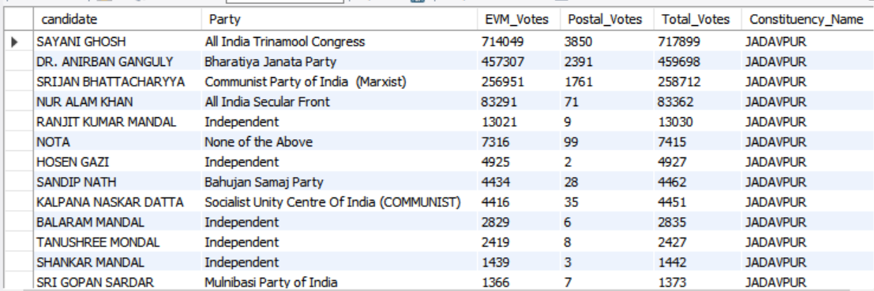
10- What is the distribution of EVM votes versus postal votes for candidates in a
specific constituency?*/
select cd.candidate, cd.Party, cd.EVM_Votes, cd.Postal_Votes,
cd.Total_Votes, cr.Constituency_Name
from constituencywise_details cd
inner join constituencywise_results cr ON cd.Constituency_ID = cr.Constituency_ID
where cr.Constituency_Name = 'JADAVPUR'
order by cd.Total_Votes desc;

Slide 22
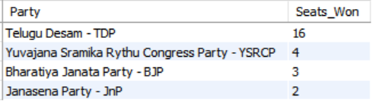
11- Which parties won the most seats in “Andhra Pradesh”, and how many seats did each party win?
select pr.Party,
count(Constituency_ID) as Seats_Won
from constituencywise_results as cr
inner join Partywise_results pr ON cr.Party_ID = pr.Party_ID
inner join statewise_results sr ON cr.Parliament_Constituency = sr.Parliament_Constituency
inner join states s ON sr.State_ID = s.State_ID
where s.State = 'Andhra Pradesh'
group by pr.Party
order by Seats_Won desc;

Slide 23
12- What is the total number of seats won by each party alliance (NDA, I.N.D.I.A, and OTHER)
in each state for the India Elections 2024*/
SELECT
s.State AS State_Name,
SUM(CASE WHEN p.party_alliance = 'N.D.A' THEN 1 ELSE 0 END) AS NDA_Seats_Won,
SUM(CASE WHEN p.party_alliance = 'I.N.D.I.A' THEN 1 ELSE 0 END) AS INDIA_Seats_Won,
SUM(CASE WHEN p.party_alliance = 'OTHERS' THEN 1 ELSE 0 END) AS OTHER_Seats_Won
FROM
constituencywise_results cr
JOIN

Slide 24
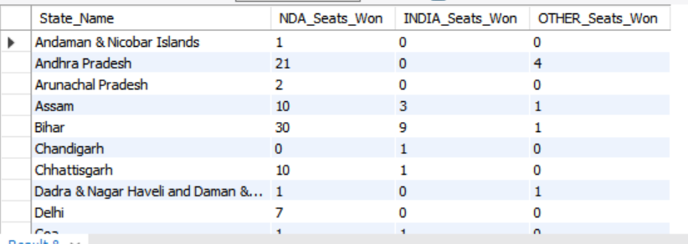
partywise_results p ON cr.Party_ID = p.Party_ID
JOIN
statewise_results sr ON cr.Parliament_Constituency = sr.Parliament_Constituency
JOIN
states s ON sr.State_ID = s.State_ID
WHERE
p.party_alliance IN ('N.D.A', 'I.N.D.I.A', 'OTHERS') -- Filter for NDA and INDIA alliances
GROUP BY
s.State
ORDER BY
s.State;

Slide 25
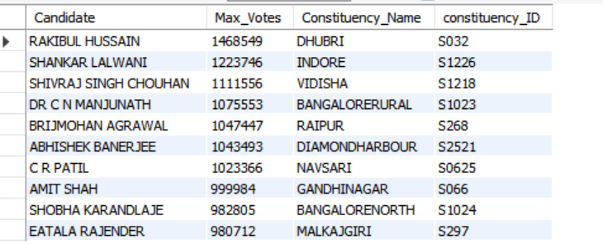
13- Which candidate received the highest number of EVM votes in each constituency (Top 10)?
SELECT cd.Candidate, max(cd.EVM_Votes) as Max_Votes , cr.Constituency_Name, cr.constituency_ID
from constituencywise_details cd
inner join constituencywise_results cr ON cd.Constituency_ID = cr.Constituency_ID
GROUP BY cr.Constituency_Name, cd.Candidate, cr.constituency_ID
order by Max_Votes desc
LIMIT 10;

Slide 26
14- Which candidate won and which candidate was the runner-up in each constituency of State for the 2024 elections?*/
WITH RankedCandidates AS (
SELECT
cd.Constituency_ID, cd.Candidate, cd.Party, cd.EVM_Votes, cd.Postal_Votes,
cd.EVM_Votes + cd.Postal_Votes AS Total_Votes,
ROW_NUMBER() OVER (PARTITION BY cd.Constituency_ID ORDER BY cd.EVM_Votes + cd.Postal_Votes DESC) AS VoteRank
FROM constituencywise_details cd
JOIN
constituencywise_results cr ON cd.Constituency_ID = cr.Constituency_ID
JOIN
statewise_results sr ON cr.Parliament_Constituency = sr.Parliament_Constituency
JOIN
constituencywise_results cr ON cd.Constituency_ID = cr.Constituency_ID
JOIN

Slide 27
states s ON sr.State_ID = s.State_ID
WHERE s.State = 'Maharashtra'
)
SELECT
cr.Constituency_Name,
MAX(CASE WHEN rc.VoteRank = 1 THEN rc.Candidate END) AS Winning_Candidate,
MAX(CASE WHEN rc.VoteRank = 2 THEN rc.Candidate END) AS Runnerup_Candidate
FROM
RankedCandidates rc
JOIN
constituencywise_results cr ON rc.Constituency_ID = cr.Constituency_ID
GROUP BY
cr.Constituency_Name
ORDER BY
cr.Constituency_Name;

Slide 28
2nd Method –
SELECT
cd.Candidate, cd.Constituency_ID, cr.Constituency_Name, sr.State,
cd.EVM_Votes + cd.Postal_Votes AS Total_Votes,
ROW_NUMBER() OVER (PARTITION BY sr.State ORDER BY cd.EVM_Votes + cd.Postal_Votes DESC) AS State_Vote_Rank
FROM
constituencywise_details cd
INNER JOIN
constituencywise_results cr ON cd.Constituency_ID = cr.Constituency_ID
INNER JOIN
statewise_results sr ON cr.Parliament_Constituency = sr.Parliament_Constituency
LIMIT 2;

Slide 29
15- For the state of Maharashtra, what are the total number of seats, number of candidates,
number of parties, total votes (including EVM and postal), and the breakdown of EVM and postal votes?*/
Select s.State,
COUNT(DISTINCT cr.Constituency_ID) as Total_Seats,
COUNT(DISTINCT cd.Candidate) as Total_Candidates,
COUNT(DISTINCT pr.Party) as Total_Party,
SUM(cd.EVM_Votes + cd.Postal_Votes) as Total_Votes,
SUM(cd.EVM_Votes) as Total_EVM_Votes,
SUM(cd.Postal_Votes) as Total_Postal_Votes
from Constituencywise_details cd
inner join Constituencywise_results cr ON cd.Constituency_ID = cr.Constituency_ID

Slide 30
inner join statewise_results sr ON sr.Parliament_Constituency = cr.Parliament_Constituency
Inner join Partywise_results pr ON pr.Party_ID = cr.Party_ID
inner join States s ON sr.State_ID = s.State_ID
where s.State = 'Uttar Pradesh’;

Slide 31
Outcomes and Skills Gained:
This project provided hands-on experience with real-world data, simulating a professional data analysis scenario. It enabled me to:
Develop a deep understanding of SQL for real-world applications.
Gain expertise in managing and analyzing large datasets.
Acquire advanced problem-solving skills by tackling real-life data challenges.

Slide 32
Why This Project Matters:
Analyzing the 2024 India General Elections results was not only an enriching technical experience but also a valuable opportunity to understand how SQL is used in real-world analytical contexts. This project serves as an excellent addition to my skillset and portfolio, showcasing my ability to handle advanced SQL tasks and derive actionable insights from complex data.

